Slide 1
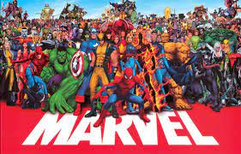
Report on Marvel APIs
Repo Link: CLICK HERE
Stan Leevasz

Slide 2
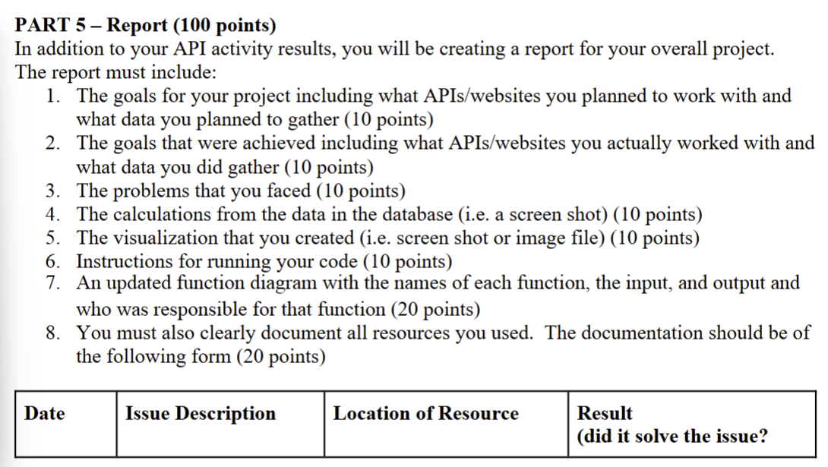

Slide 3
Planned: Project Goal, APIs Used, & Data Gathered
The project’s goal is to investigate the representation of different identities in superhero media.
APIs Used:
  Superhero API: https://superheroapi.com/try-now.html
  Comic Vine API: https://comicvine.gamespot.com/api/documentation
  Marvel Rivals API: https://marvelrivalsapi.com/
  MCU Countdown: https://github.com/DiljotSG/MCU-Countdown
Gathered Data:
  Height & weight of superheroes, gender of superheroes, birthplace of superheroes, movies & comics appearances of superheroes.
  Seeing representation in:
    BMI
    Gender
    Birthplace
    Comics
    Movies
    Games
Notes:
Stanford

Slide 4
Achieved: Project Goal, APIs Used, & Data Gathered
The project’s goal is to investigate the representation of different identities in superhero media.
APIs Used:
  Superhero API: https://superheroapi.com/try-now.html
  Comic Vine API: https://comicvine.gamespot.com/api/documentation
  Marvel Rivals API: https://marvelrivalsapi.com/
Gathered Data:
  Height & weight of superheroes, gender of superheroes, birthplace of superheroes, & comics appearances of superheroes.
  Seeing representation in:
    BMI
    Gender
    Birthplace
    Comics
    Games
Notes:
Blake

Slide 5
Problems Faced
Had to transition from using MCU Countdown to Marvel Rivals API
  MCU Countdown only gave us data for the upcoming movie, not previous Marvel films
No movie data
  Comic Vine’s documents weren’t up to date
    we couldn’t find how many movies certain heroes were featured in
    Moved to number of comics heroes were in
429 Errors
  Largely occurred when problem solving data issues
Excluding non-Marvel heroes from lists
Notes:
Blake

Slide 6
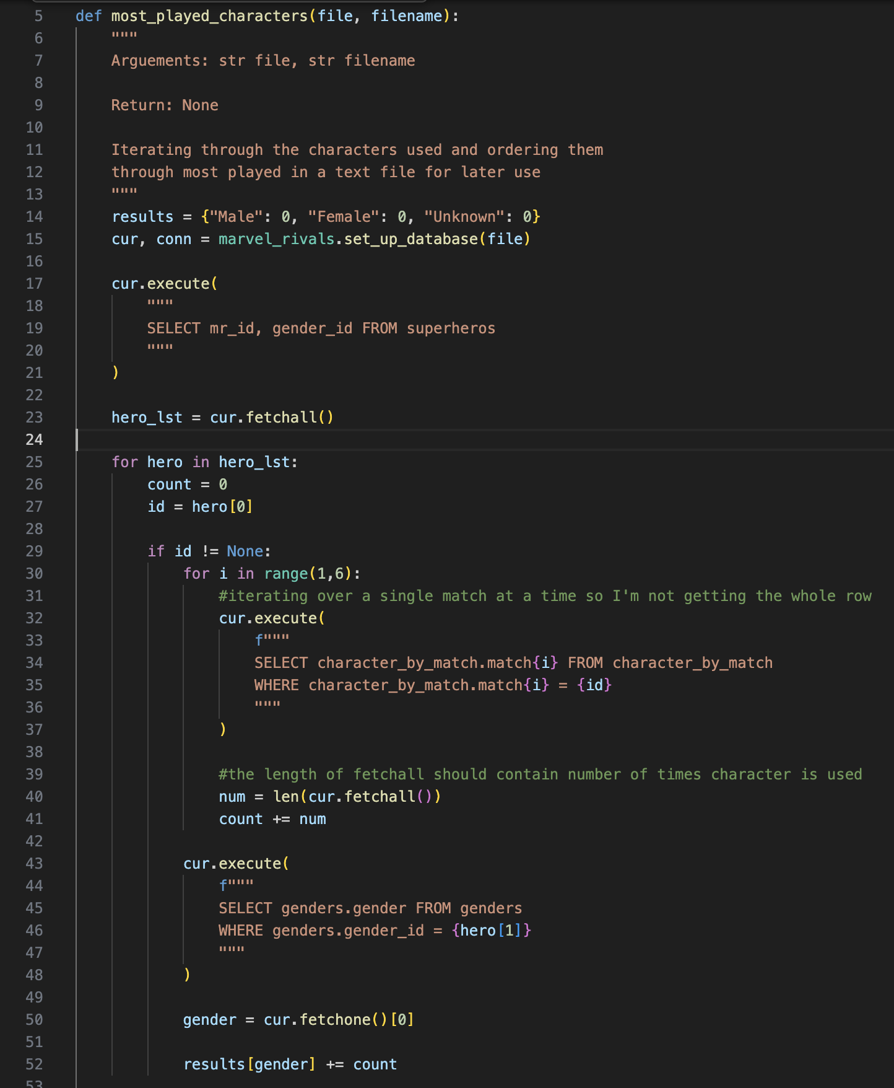
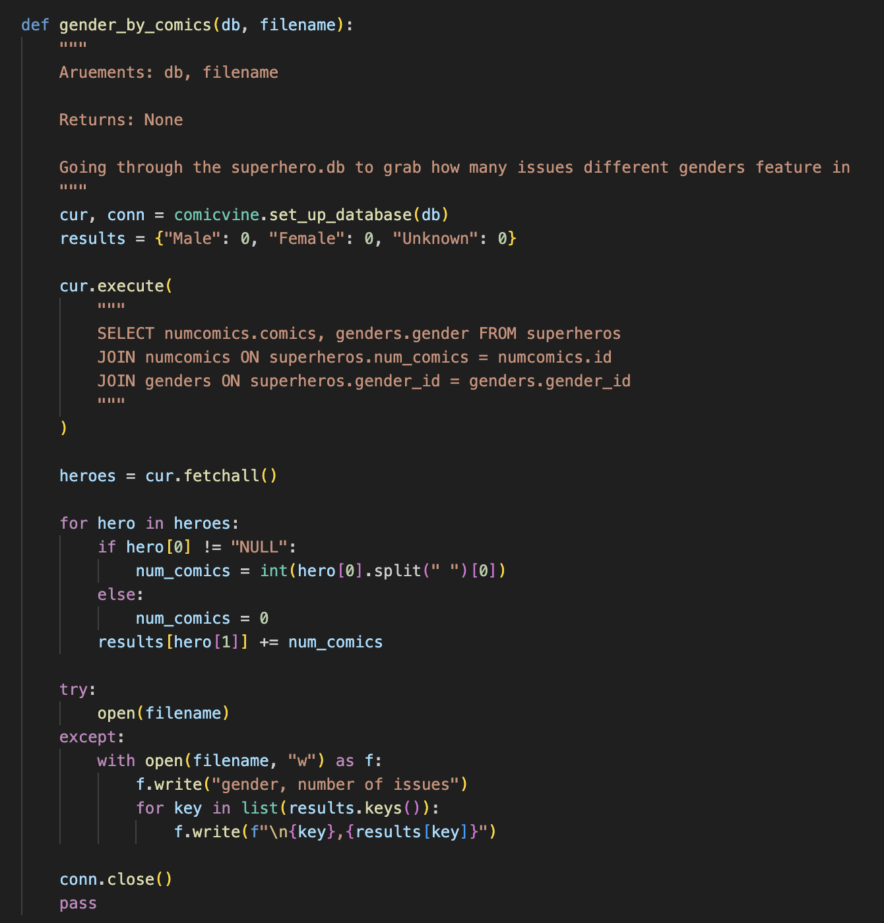
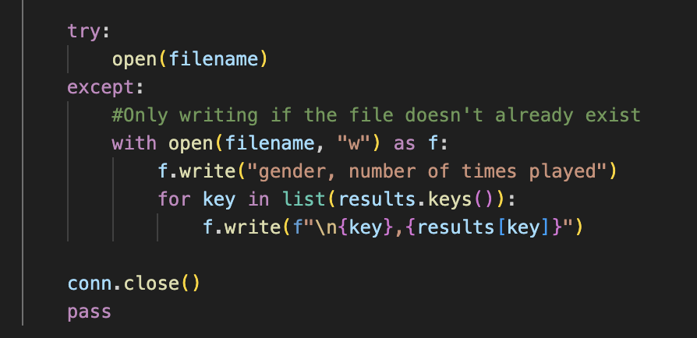
Calculations from Data in Database - Blake
Notes:
Blake & Stan

Slide 7
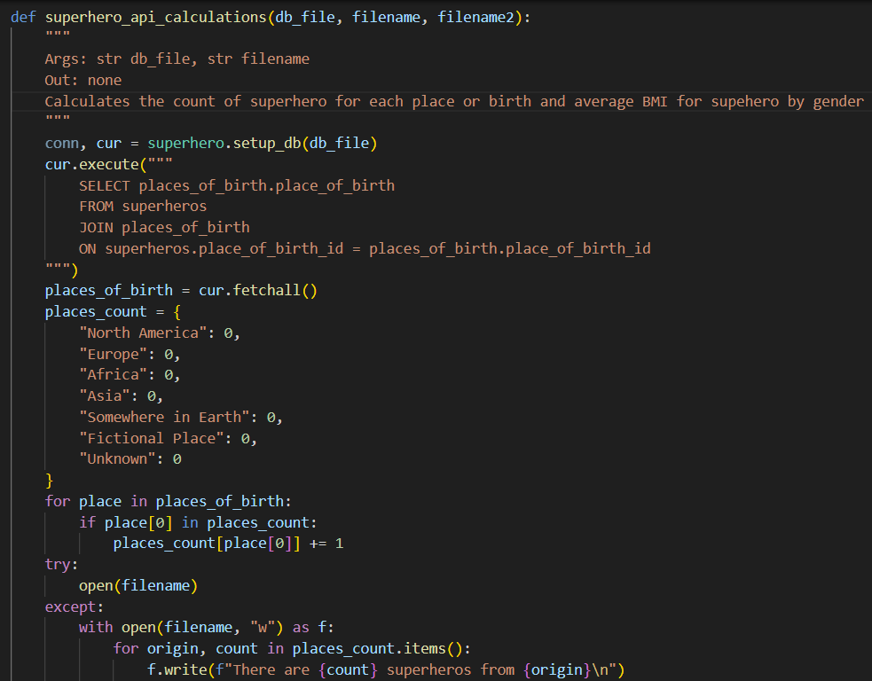
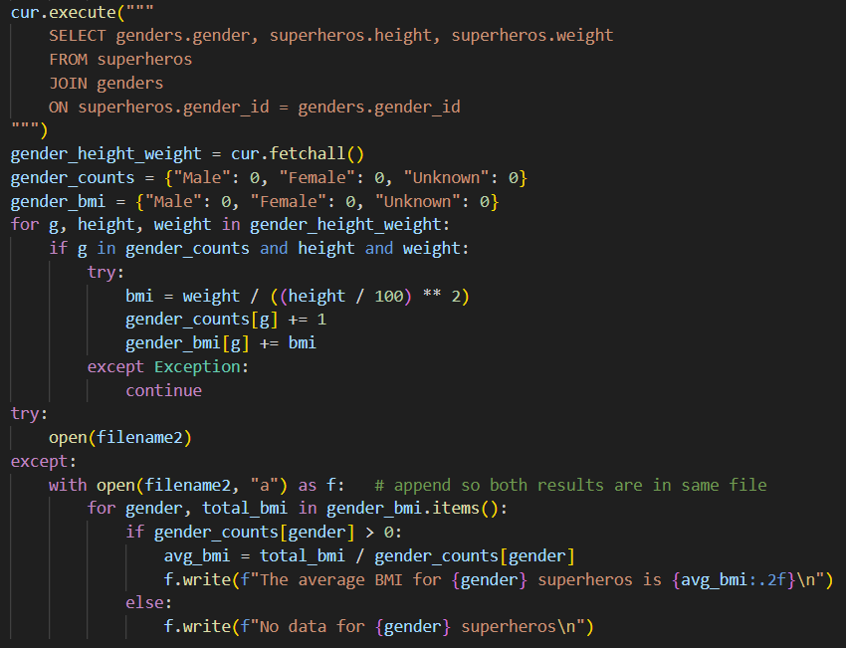
Calculations from Data in Database - Stan

Slide 8
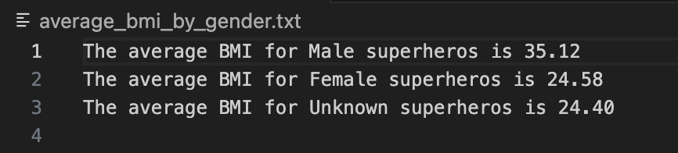
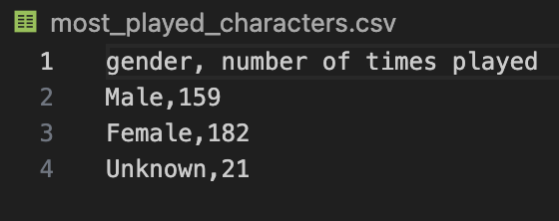
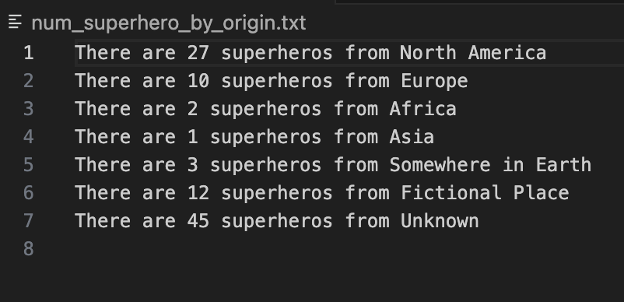
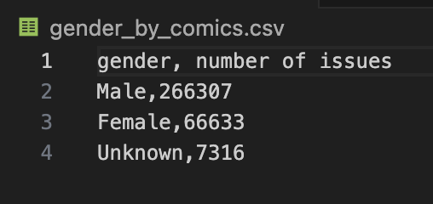
Calculations Cont.

Slide 9
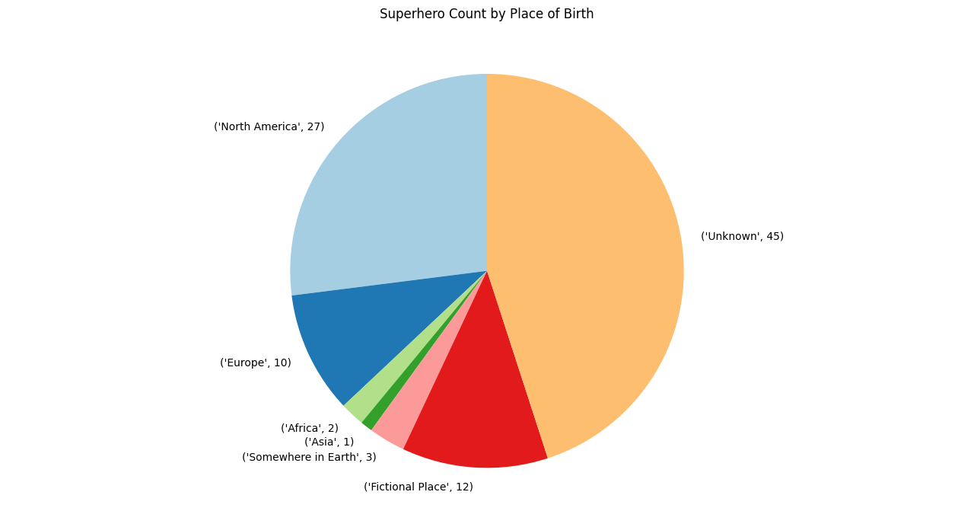
Visualizations Created
Notes:
Blake & Stan

Slide 10
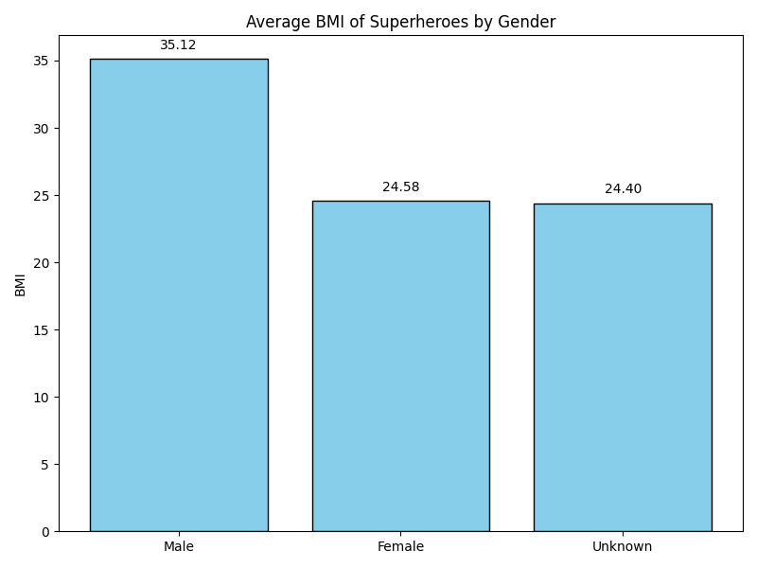

Slide 11
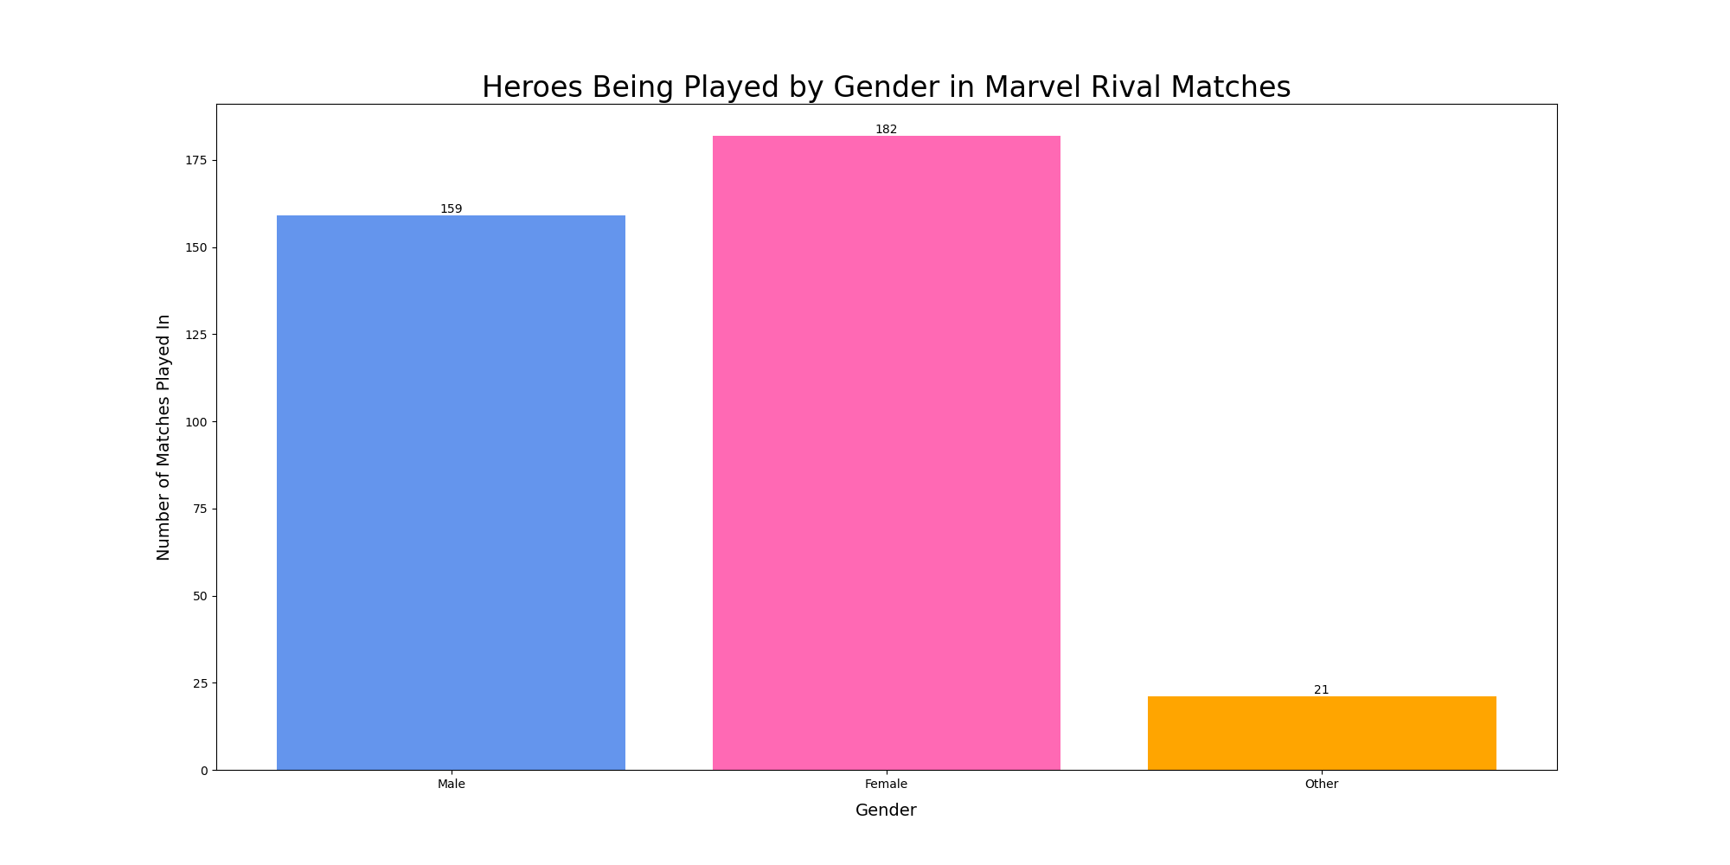

Slide 12
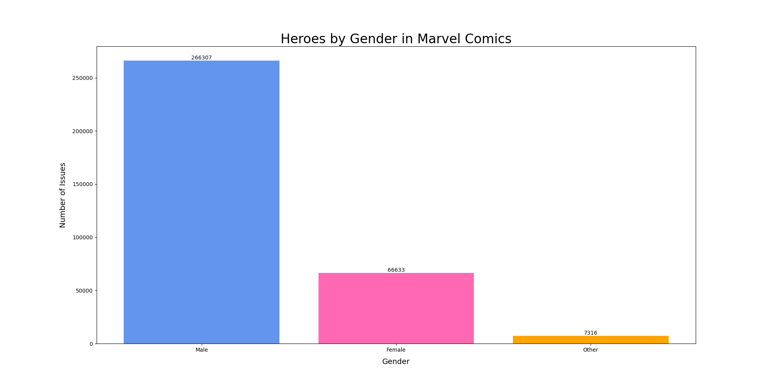

Slide 13
Instructions for Running the Code
1. Create an API key from https://superheroapi.com/, https://comicvine.gamespot.com/api/, and https://marvelrivalsapi.com/.
2. Insert each API key into the “replace text with key” on each corresponding line in the api_keys.txt file.
3. Run the superhero.py file 4 times first to create and populate the main database: superhero.db.
4. Run the marvel_rivals.py 4 times to create and populate its tables to the superhero.db database.
5. Run the comicvine.py file 9 times (or until "Finished searching for data!" prints) to create and populate its tables to the superhero.db database.
6. Run the calculations.py file to perform calculations using data from the superhero.db database to create the data calculations files: gender_by_comics.csv, most_played_characters.csv, num_superhero_by_origin.txt, and average_bmi_by_gender.txt.
5. Run the bl-visuals.py and sj-visuals.py files to create the visualizations from calculated data.
Notes:
Stanford

Slide 14
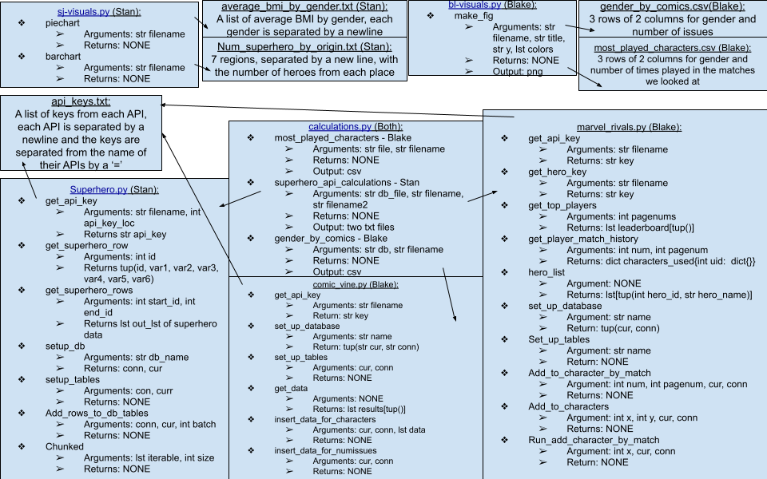
Function Diagram
Notes:
Blake

Slide 15
Resources Used
Date | Issue Description | Location of Resource | Result (did it solve the issue?)
11/18/2025 | Difficulty in getting access to Marvel Rivals API key. | https://discord.com/invite/marvelrivalsapi | Yes, the issue was solved.
11/24/2025 | Long runtime in creating a database for Superhero API. | https://prismic.io/blog/api-response-times | Yes, the issue was solved.
12/1/2025 | References for colors and text for matplotlib for customization of the charts | https://matplotlib.org/stable/api/matplotlib_configuration_api.html | Yes, the issue was solved.
Notes:
Stanford
Marvel Rivals API Discord (Blake)

